Slide 1
Analysis of hospital based ayurvedic clinical practice to gain real world data knowledge
Vinay Mahajan
Objective 1: Nature of data, arranging data for analysis
PhD thesis presentation
Guides: Ashwini Godbole, Girish Tillu, Ashwini Mathur
Notes:
Micro as well as macro level analysis is possible
Zoom in and zoom out
Possible usages:
1. Clinical Research
2. Pricing and Market Access
3. Pre-Approval Communication and Scientific Exchange
4. Promotional Interactions and Content
5. Fees for Service
6. Interactions with Patients and Patient Organizations
7. External training
The ADSL data useful for:
This has not been done since 2011 in the hospital as well as this kind of analysis has not taken place in Ayurvedic area.
Individual patient comprehensive view –
Covering all diseases reported as per visit
Corresponding medicines prescribed
Corresponding services prescribed
Covering complete In patient and Out patient information for the patient
Has been generated.
A subset of patients experiencing similar diseases is possible,
A subset of patients prescribed with a specific medicine is possible.
Complicated combinations of patients having certain diseases reported before and after certain diseases is possible.
Similar combinations of treatments
Patient ID is not present in each domain, but patient visit is used as the primary key [may be a suboptimal way to set-up the database]
RMSD patients visit the hospital premises more often than that of the metabolic patients.
More out patient visits compared to in patient visits.

Slide 2
Disclaimer
The following analysis should be seen from a learning point of view, a framework for Ayurvedic EHR analysis
This is a neutral view of the analysis – should not be taken as a criticism of the practices at the hospital
This analysis is retrospective and should be used to improve the data standards, documentation practices
A humble attempt to add to the already existing evidence base for Ayurveda

Slide 3
Ayurveda and its development
Assumptions:
Conceptual developments: everyday observations and basic laws of nature (real world experience)
Necessary adjustments as per the passage of time based on observations and experiences (real world experience)
Ayurveda is practiced more in clinics (real world experience) than in clinical research setting,
No artificial restrictions
on usage of medicines
duration of treatment or
type of patients to treat
A big challenge in a protocol driven clinical trial setting
Data
Data
Based on imminent thought leaders in the field of ayurveda

Slide 4
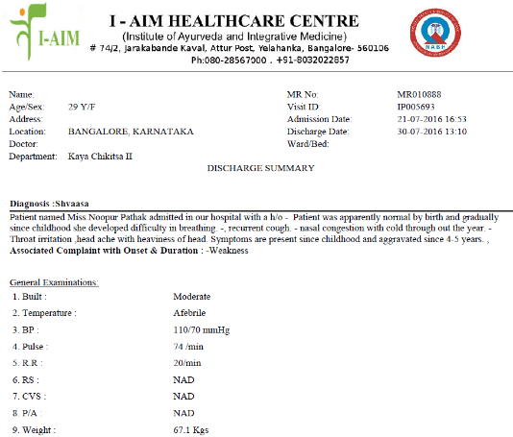
From a patient to ...
TDU - IAIM Hospital database Bengaluru
Data version: 2011 to Oct 2017
Reasonably large Ayurvedic electronic databases operational since 2011
Total number of patients treated more than 50,000
Out patients = ~45,000
In patients = ~7,000 (* some patients are both Out patient / in patient)
~1,70,000 out patient visits
Patients from more than 50 countries
More than 900 disease conditions treated,
More than 3000 medicines / services recorded
Implementation of Ayurvedic Clinical Dictionary for diagnosis
Operational insights
Clinical insights
New research ideas
Based on Real world experience

Slide 5
Goldmine of data should mined to gain real world data knowledge
The study targets the methodological and learning framework covering short, mid and long term influences in following categories:
Hospital managements
Clinicians and patients
Universities and learning institutes – clinical communication, researchers to build vital evidence-base
Policy makers – AYUSH and relevant ministries
Healthcare providers - Ayurveda Healthcare systems, General healthcare systems

Slide 6
Information generators and Information users
Hospital administration
Patients
Doctors
Nurses
Pathology reports
Pharmacists
Legal and regulatory needs
Users
Information users
Regulatory bodies
Ayurvedic researchers
Insurance companies
Policy makers
Statisticians
Research scientists
Generators

Slide 7






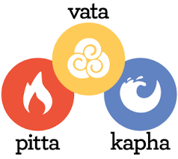



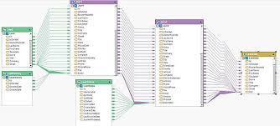
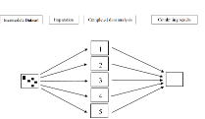




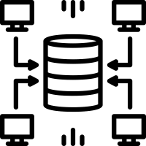




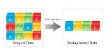
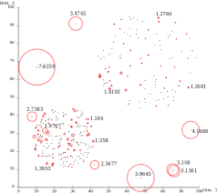
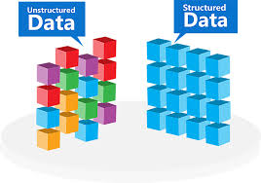

Flow diagram
Data
Knowledge
Wisdom
Hospital visit | Assessments | Electronic Medical health record
Data Sources | Staging area | Ware house | Data marts | Usage
Data access: |  |  |  | Hospital management Researchers Health authorities Various documents Data mining
Operational system Coding dictionaries Clinical system Flat files information | Calculations and transformations | Curated and consistent data storage | Operational data Pharmacy data Patient level data

Slide 8
Statistical programming / Clinical programming / Ayurdata expert*
Statistical programmers play a key role in
turning the data into knowledge and
supporting the development of new medicines
Statistical programmer
Converts raw data to analyzable data
Performs data checks
Creates Tables, Listings, Figures (visualizations)
Customizes the data to produce an output which displays the behavior of the data
Inference of the data is done using the TFLs
Not an IT person
Not just a statistician
Not a data manager (cleaning the data)
Not a database developer to store the data
Uses IT systems
Uses statistician’s mind
Provides insights into building database
Scientific rigor
Uses multiple technologies
Uses ideas to convert
An observation to summaries to Stories
Clinical insights w/o being a doctor
Pioneering effort and new contributions: as this kind of work was never done in ayurvedic area
*: new skill

Slide 9
Questions
Hospital management | Regulatory / insurance | Teaching / PhD / MD
Number of patients Patient characteristics % of males / females The age groups Countries, states, cities Number of visits Visit patterns Number of In / Out Patients Assessments done at visit Overall duration of visits Reported diseases Number of diseases Operational insights Pharmacy | Evidence base generation (EBM): integration of best research evidence with clinical expertise, patient and parents’ preferences Use these data as “secondary use” Labels of medicines and prescriptions in the database match each other Metal based treatments and related discussions Initiation of “Ayurvedic registry” Cost per visit | Data as a supplementary material for PhD / MD Data: as an additional teaching material for college students Rare disease identification Cohort generation: Understand the natural history What is the meaning of cohort in ayurvedic area? Predict any questions, trajectory of diseases, etc. Predicting the next complication or next disease, when and what? Quantifying the effect of intervention Construct evidence based guidelines

Slide 10
Questions
Hospital doctors | Publications / Research proposals | General public / popular articles
Individual patient data and how are the treatments prescribed Diseases differences in gender, season, age group Disease – disease combination Higher / lower diseases and natural occurrences Prescription of treatments | Data backed proposals for research grants Case report / series generation for publication Validation of Ayurvedic treatment protocols In absence of “hard clinical end point” short term outcomes (intent adherence to the treatment) intermediate term outcomes (actual adhere) long term outcomes (overall health) Longitudinal / epidemiologic view Pre and post analysis Co-morbidity analysis | Weekly communications in local / national papers Simple short stories to build image of Ayurveda Based on the seasonal diseases, provide simple preventive measures

Slide 11
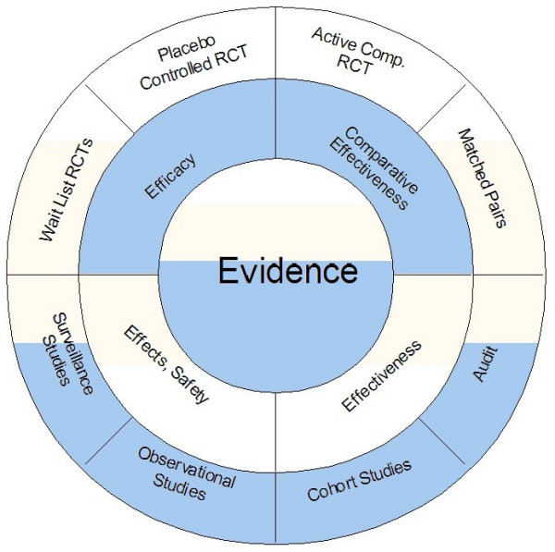
Evidence: Proposed
Approach
Real world
Clinical practice data analysis
Walach H et al. BMC Med Res Methodol. 2006, 6:29

Slide 12

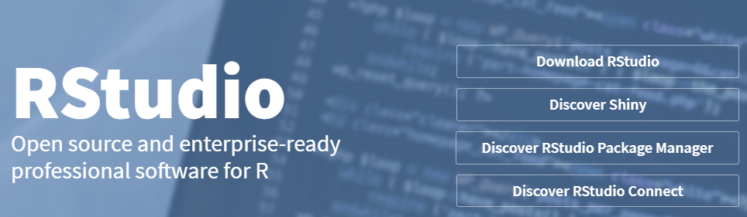


Data observations into summaries, stories

Slide 13
Data collection tables in the source database (150+ tables out of 800)
action_rights | diet_prescribed | hospital_technical | package_componentdetail | patient_registration | section_field_options | store_item_batch_details | test_details
admission | discharge_format_detail | icu_bed_charges | package_item_charges | patient_section_details | service_consumable_usage | store_item_details | test_org_details
anesthesia_type_charges | doctor_charges_backup | ip_bed_details | package_prescribed | patient_section_details_orig | service_documents | store_item_lot_details | test_results_master
area_master | doctor_charges_op_backup | ip_prescription | patient_activities | patient_section_forms | service_master_charges | store_patient_indent_details | test_visit_report_signatures
bed_details | doctor_consultation | item_supplier_prefer_supplier | patient_consultation_field_values | patient_section_image_details | service_master_charges_backup | store_patient_indent_main | test_visit_reports
bill | doctor_consultation_charge | manf_master | patient_demographics_mod | patient_section_values | service_org_details | store_po | tests_conducted
bill_activity_charge | doctor_medicine_favourites | medicine_dosage_master | patient_deposits | patient_service_prescriptions | services | store_po_main | tests_prescribed
bill_adjustment | doctor_op_consultation_charge | medicine_id_health_authority_unique | patient_deposits_setoff_adjustments | patient_test_prescriptions | services_prescribed | store_reagent_usage_details | theatre_charges
bill_charge | doctor_org_details | message_recipient | patient_details | ppfv_form_detail_id | stk_chkpt | store_reagent_usage_main | u_user
bill_charge_adjustment | dyna_package_category_limits | mrd_casefile_attributes | patient_details_patient_phone_country_code | preauth_prescription | stock_issue_details | store_reorder_levels | url_action_rights
bill_receipts | dyna_package_charges | mrd_codes_doctor_master | patient_discharge | preauth_prescription_activities | stock_issue_main | store_retail_customers | user_services_depts.
complaintslog | dyna_package_org_details | mrd_codes_master | patient_documents | prescribed_medicines_master | store_adj_details | store_sales_details | visit_vitals
consultation_charges | equipement_charges | mrd_diagnosis | patient_general_docs | progress_notes | store_adj_main | store_sales_main | vital_reading
consultation_org_details | estimate_bill | mrd_observations | patient_hvf_doc_values | registration_charges | store_checkpoint_details | store_stock_details
deposit_setoff_total | estimate_charge | operation_charges | patient_medicine_prescriptions | sample_collection | store_estimate_details | store_transaction_lot_details
diagnostic_charges | favourite_reports | operation_org_details | patient_other_medicine_prescriptions | sch_resource_availability | store_grn_details | store_transfer_details
diagnostic_charges_backup | fixed_asset_master | other_services_prescribed | patient_other_prescriptions | sch_resource_availability_details | store_grn_main | store_transfer_main
diagnostic_reagent_usage | follow_up_details | outsource_sample_details | patient_packages | scheduler_appointment_items | store_indent_details | supp_inv_id
diagnostics | growth_chart_reference_data | pack_org_details | patient_pdf_form_doc_values | scheduler_appointments | store_indent_main | supplier_master
diet_charges | ha_item_code_type | package_charges | patient_prescription | screen_rights | store_invoice | temp_stock_item_batch_with_diff_mrp_expdt
TDU hospital database

Slide 14
Data observations into summaries, stories
Generic algorithm and steps followed
Use R program to generate tabular or graphical analysis
Use source tables from the SQLserver
Use SQL queries to combine necessary tables
Use R program to create analysis data tables
150+ tables in SQL
25+ tables used for calculations
13 tables converted
6 tables “staging tables”
1 reference dataset: ~65 variables
50 Steps from start to end
Use Tableau to generate interactive visual analysis
8 tables converted to
95+ CRF pages and 515 variables
25 Steps from start to end
Login on the SQL server using the credentials
Use the IAIM schema, access following tables to generate base table with
Demographics information, Patient Visit information and prescribed treatments
STATE_MASTERa
COUNTRY_MASTER
CITY
STATE
PATIENT_DETAILS
PATIENT_REGISTRATION
MRD_DIAGNOSIS
PATIENT_PRESCRIPTION
PATIENT_MEDICINE_PRESCRIPTIONS
IP_PRESCRIPTION
SERVICES_PRESCRIBED
SERVICES
MEDICINE_SALES_VIEW
There are many CRF pages built to collect relevant Ayurvedic data, measurement data, Hospital visit data, food / exercise advice, etc.
This data is present in the following tables:
PATIENT_SECTION_DETAILS
PATIENT_SECTION_VALUES
SECTION_MASTER
SECTION_FIELD_OPTIONS
SECTION_FIELD_DESC
PATIENT_CONSULTATION_FIELD_VALUES
The datasets created in steps 2 and 3 are further processed using R programming language and the analysis ready datasets are created

Slide 15
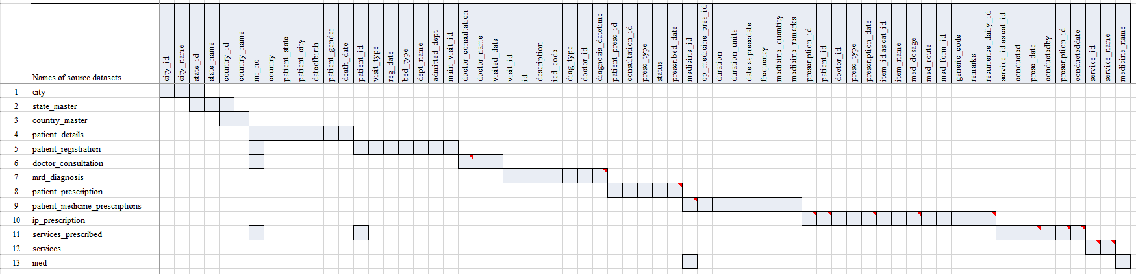
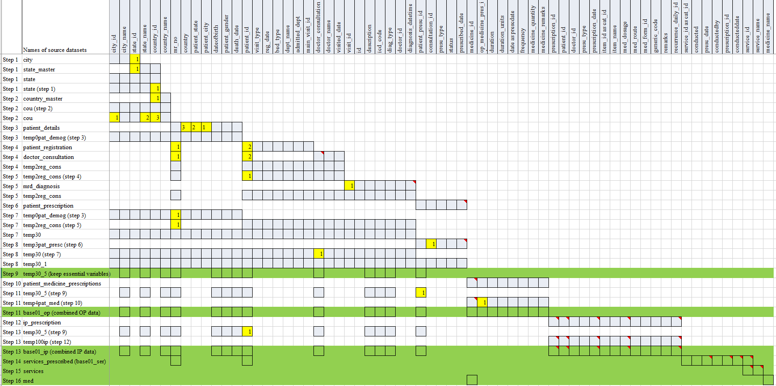
Flow of steps: from source data to analyzable format, 1 example

Slide 16
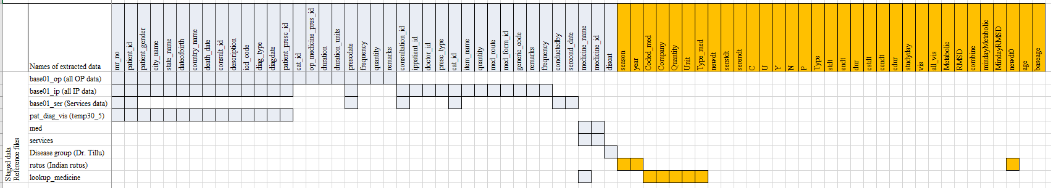
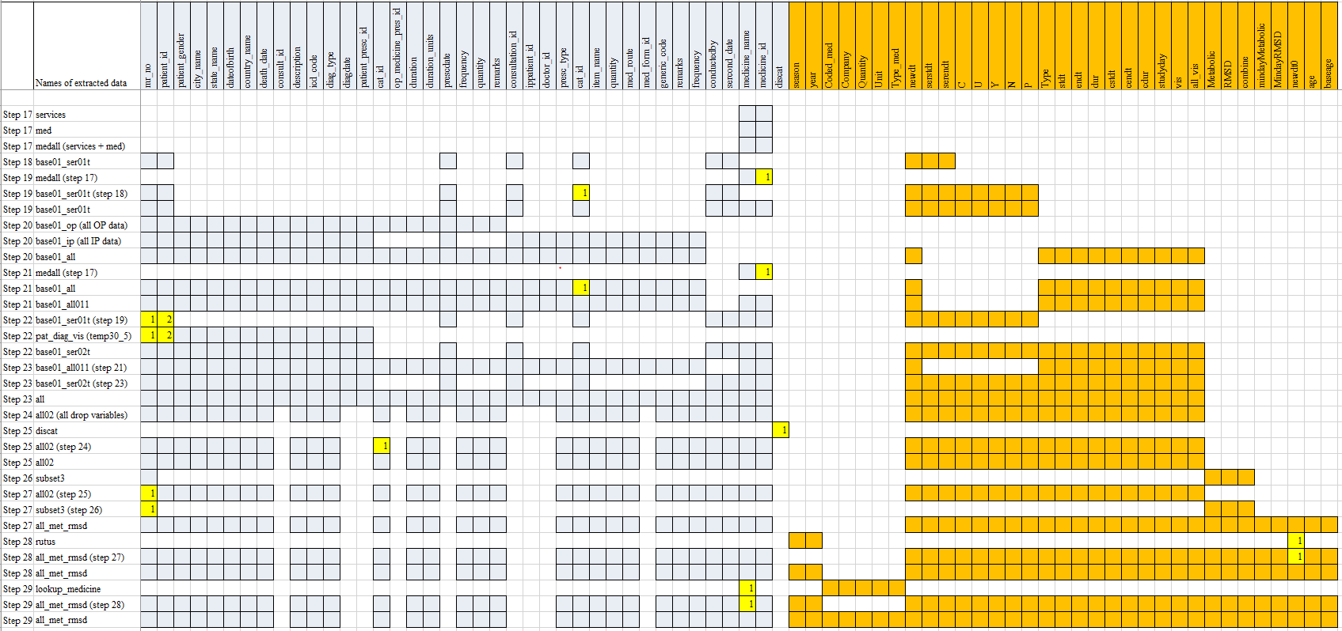
Flow of steps: from source data to analyzable format, 1 example

Slide 17
Versions of data used in various analysis
Data version | Version 1 | Version 2 | Version 3
Date time frame | From start of the hospital to Oct 2016 | From start of the hospital to Oct 2017 | PDF file version of data for 15 In Patients
Data domains | Lab Vital signs Diagnosis | All the available data in the hospital database | Specific patient visits case report forms

Slide 18
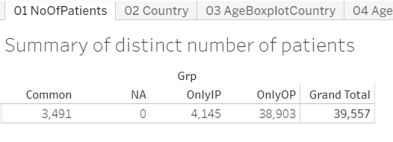
Hospital status (1/7)
Data version: 2011 to Oct 2016
HOSP MGMT
DOC /PATIENT
RESEARCH
AYUSH
HEALTHCARE
https://public.tableau.com/views/04_patient_analysis_tablaeu/05bNoOfDis_agebox?:display_count=y&:origin=viz_share_link

Slide 19
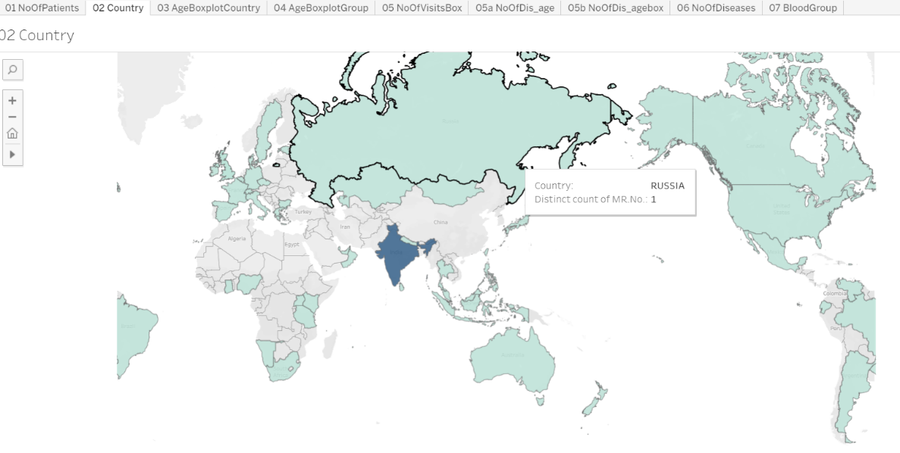
Hospital status (2/7)
Data version: 2011 to Oct 2016
HOSP MGMT
DOC /PATIENT
RESEARCH
AYUSH
HEALTHCARE
https://public.tableau.com/views/04_patient_analysis_tablaeu/05bNoOfDis_agebox?:display_count=y&:origin=viz_share_link

Slide 20
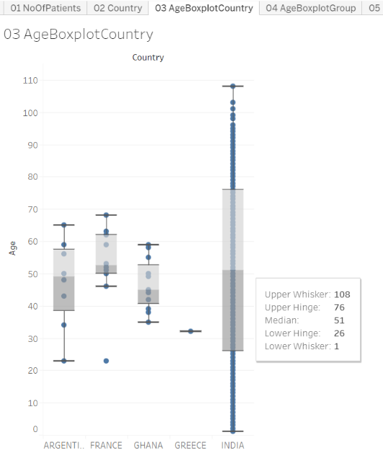
Hospital status (3/7)
Data version: 2011 to Oct 2016
HOSP MGMT
DOC /PATIENT
RESEARCH
AYUSH
HEALTHCARE
https://public.tableau.com/views/04_patient_analysis_tablaeu/05bNoOfDis_agebox?:display_count=y&:origin=viz_share_link

Slide 21
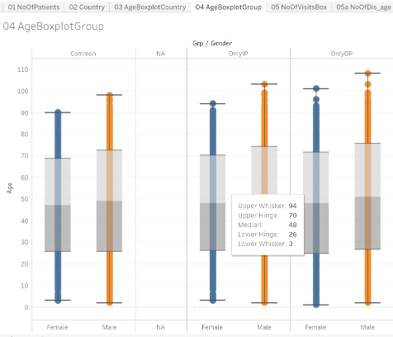
Hospital status (4/7)
Data version: 2011 to Oct 2016
HOSP MGMT
DOC /PATIENT
RESEARCH
AYUSH
HEALTHCARE
https://public.tableau.com/views/04_patient_analysis_tablaeu/05bNoOfDis_agebox?:display_count=y&:origin=viz_share_link

Slide 22
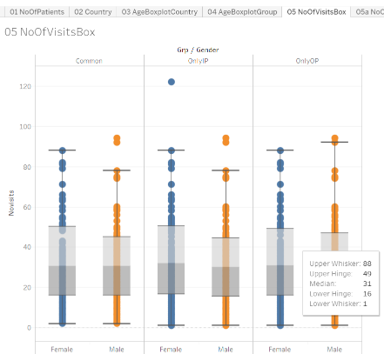
Hospital status (5/7)
Data version: 2011 to Oct 2016
HOSP MGMT
DOC /PATIENT
RESEARCH
AYUSH
HEALTHCARE
https://public.tableau.com/views/04_patient_analysis_tablaeu/05bNoOfDis_agebox?:display_count=y&:origin=viz_share_link

Slide 23
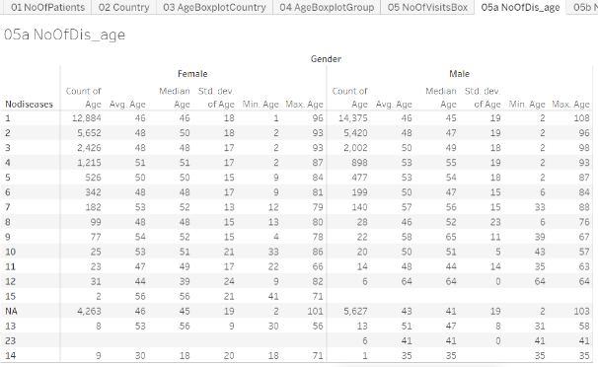
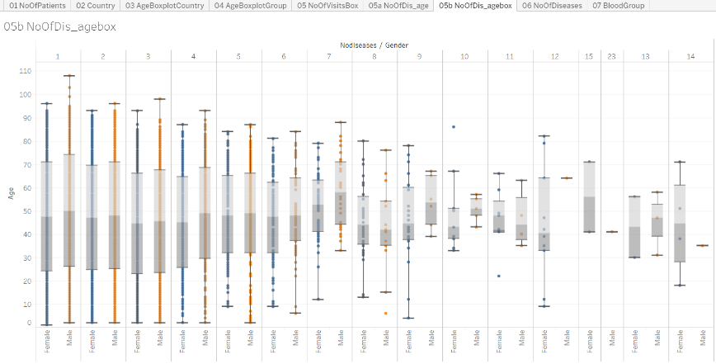
Hospital status (6/7)
Data version: 2011 to Oct 2016
HOSP MGMT
DOC /PATIENT
RESEARCH
AYUSH
HEALTHCARE
https://public.tableau.com/views/04_patient_analysis_tablaeu/05bNoOfDis_agebox?:display_count=y&:origin=viz_share_link

Slide 24
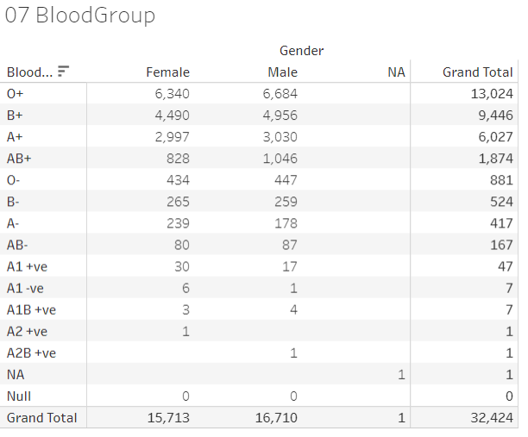
Hospital status (7/7)
Data version: 2011 to Oct 2016
HOSP MGMT
DOC /PATIENT
RESEARCH
AYUSH
HEALTHCARE
https://public.tableau.com/views/04_patient_analysis_tablaeu/05bNoOfDis_agebox?:display_count=y&:origin=viz_share_link

Slide 25
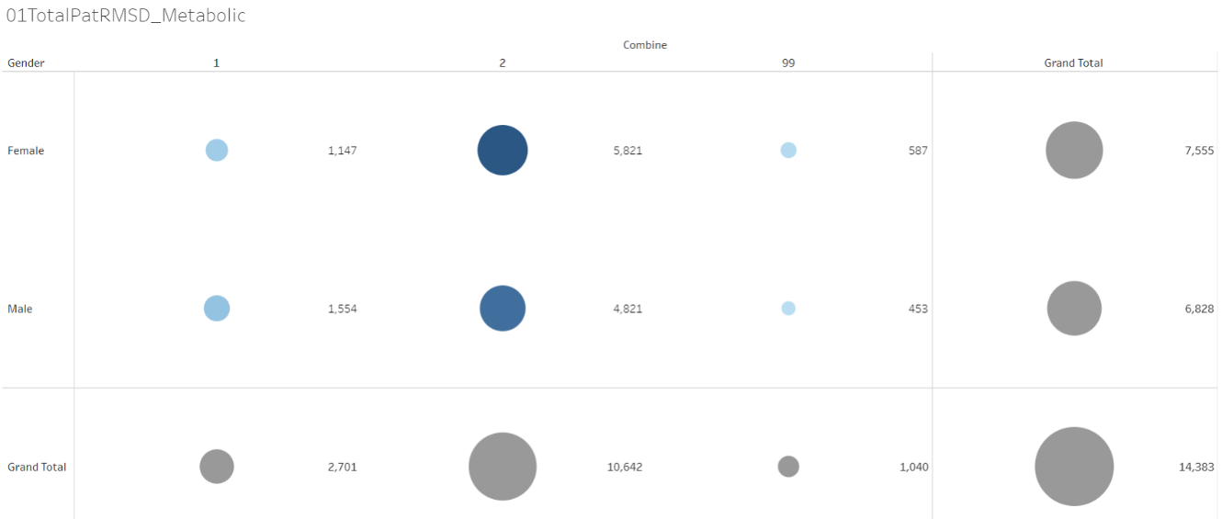
Hospital status: RMSD / Metabolic diseases (1/7)
Data version: 2011 to Oct 2016
HOSP MGMT
DOC /PATIENT
RESEARCH
AYUSH
HEALTHCARE
https://public.tableau.com/views/01RMSD_MET/01TotalPatRMSD_Metabolic?:display_count=y&:origin=viz_share_link

Slide 26
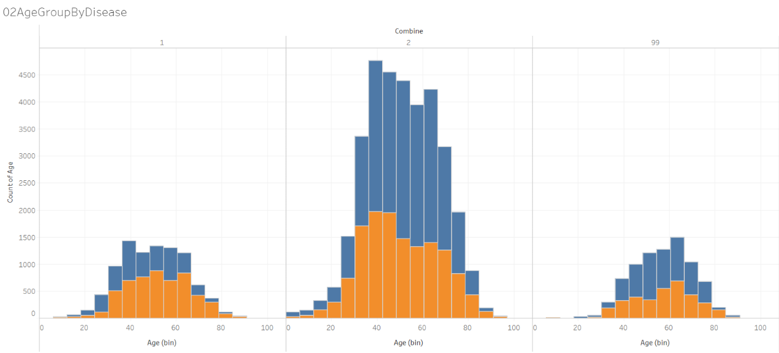
Hospital status: RMSD / Metabolic diseases (2/7)
Data version: 2011 to Oct 2016
HOSP MGMT
DOC /PATIENT
RESEARCH
AYUSH
HEALTHCARE
https://public.tableau.com/views/01RMSD_MET/01TotalPatRMSD_Metabolic?:display_count=y&:origin=viz_share_link

Slide 27
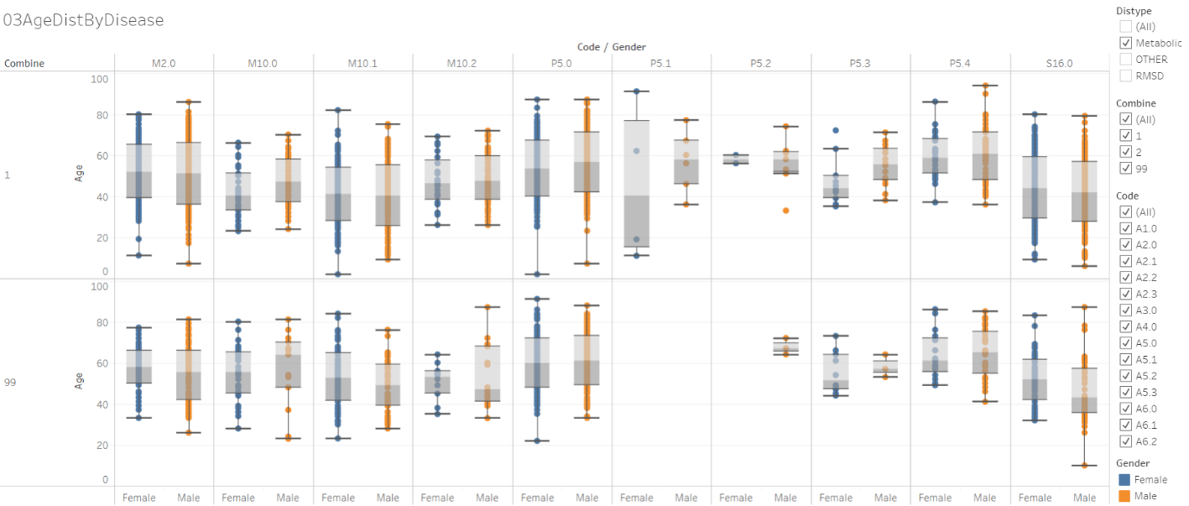
Hospital status: RMSD / Metabolic diseases (3/7)
Data version: 2011 to Oct 2016
HOSP MGMT
DOC /PATIENT
RESEARCH
AYUSH
HEALTHCARE
https://public.tableau.com/views/01RMSD_MET/01TotalPatRMSD_Metabolic?:display_count=y&:origin=viz_share_link

Slide 28
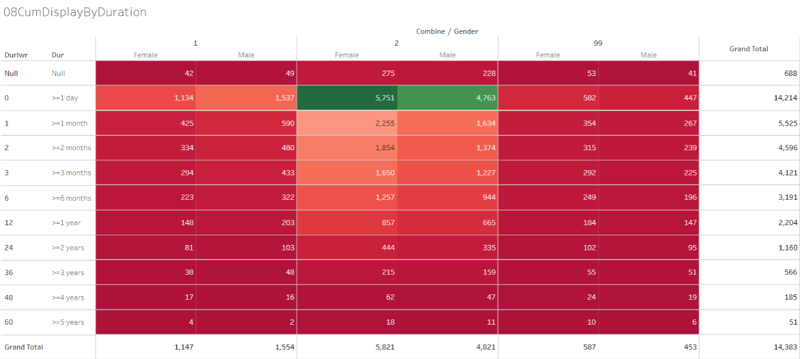
Hospital status: RMSD / Metabolic diseases (4/7)
Data version: 2011 to Oct 2016
HOSP MGMT
DOC /PATIENT
RESEARCH
AYUSH
HEALTHCARE
https://public.tableau.com/views/01RMSD_MET/01TotalPatRMSD_Metabolic?:display_count=y&:origin=viz_share_link

Slide 29
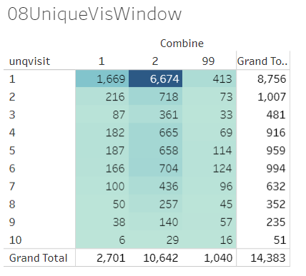
Hospital status: RMSD / Metabolic diseases (5/7)
Data version: 2011 to Oct 2016
HOSP MGMT
DOC /PATIENT
RESEARCH
AYUSH
HEALTHCARE
https://public.tableau.com/views/01RMSD_MET/01TotalPatRMSD_Metabolic?:display_count=y&:origin=viz_share_link

Slide 30
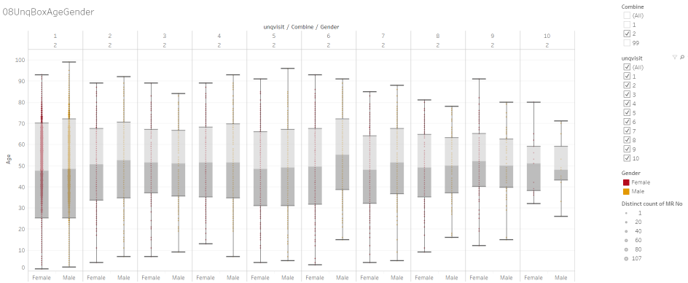
Hospital status: RMSD / Metabolic diseases (6/7)
Data version: 2011 to Oct 2016
HOSP MGMT
DOC /PATIENT
RESEARCH
AYUSH
HEALTHCARE
https://public.tableau.com/views/01RMSD_MET/01TotalPatRMSD_Metabolic?:display_count=y&:origin=viz_share_link

Slide 31
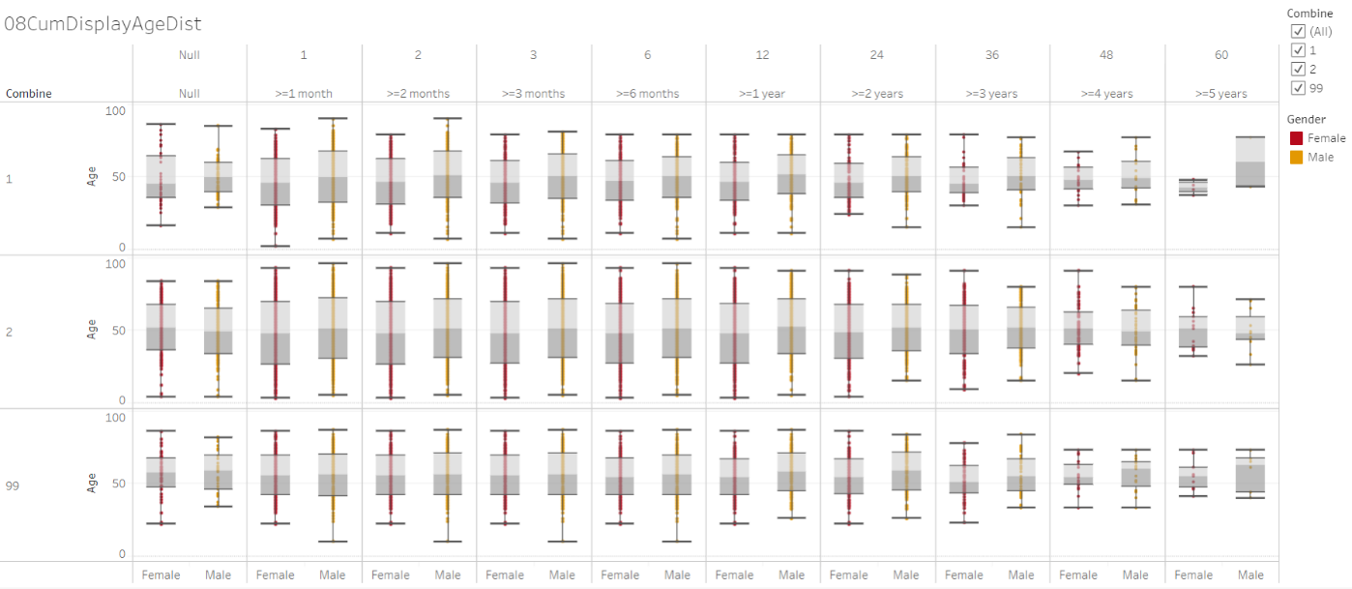
Hospital status: RMSD / Metabolic diseases (7/7)
Data version: 2011 to Oct 2016
HOSP MGMT
DOC /PATIENT
RESEARCH
AYUSH
HEALTHCARE
https://public.tableau.com/views/01RMSD_MET/01TotalPatRMSD_Metabolic?:display_count=y&:origin=viz_share_link

Slide 32
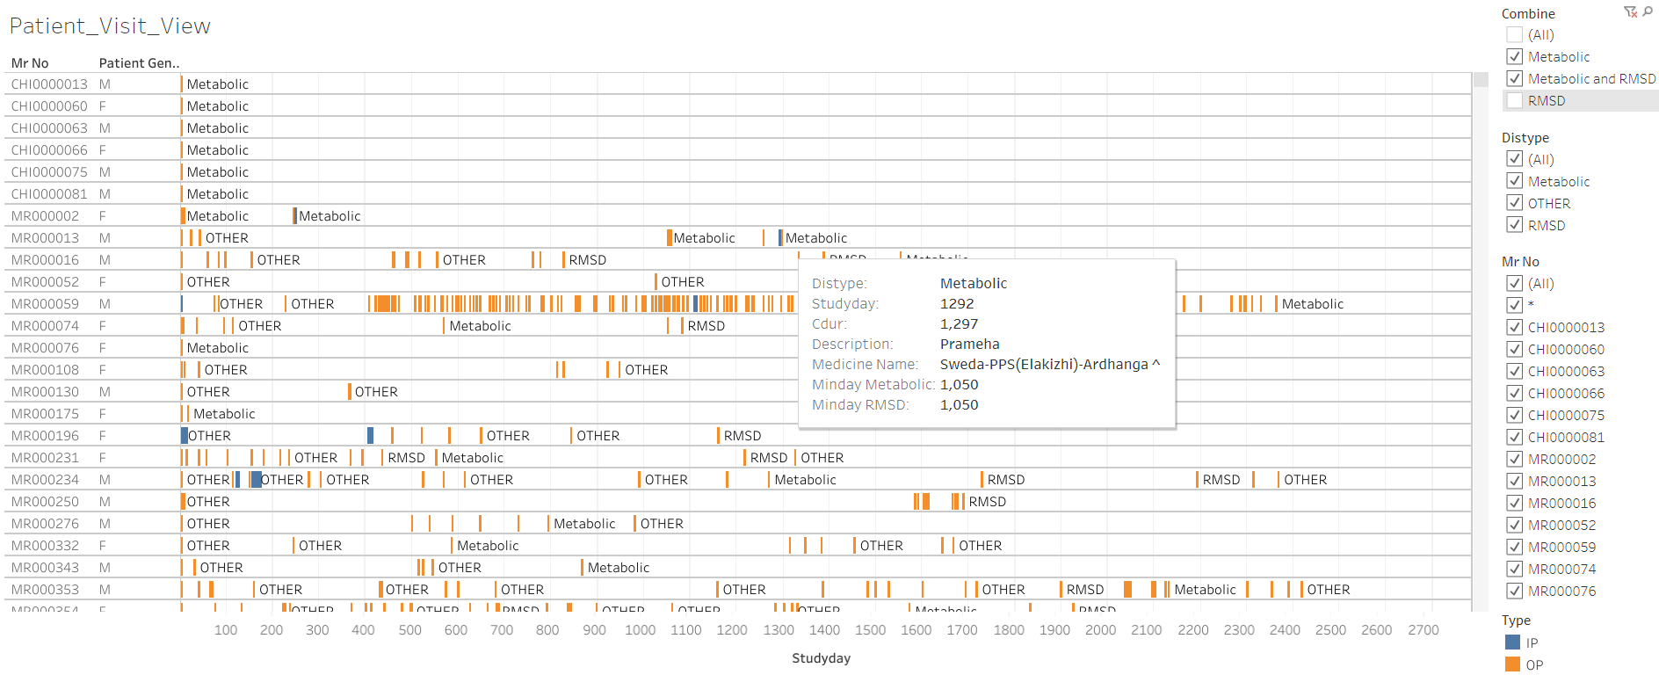
RMSD and Metabolic disease group
analysis (3/9)
Data version: 2011 to Oct 2017
HOSP MGMT
DOC /PATIENT
RESEARCH
AYUSH
HEALTHCARE
https://public.tableau.com/views/01SQL_Dis_Med_Ser/MedicineByDay?:display_count=y&:origin=viz_share_link

Slide 33
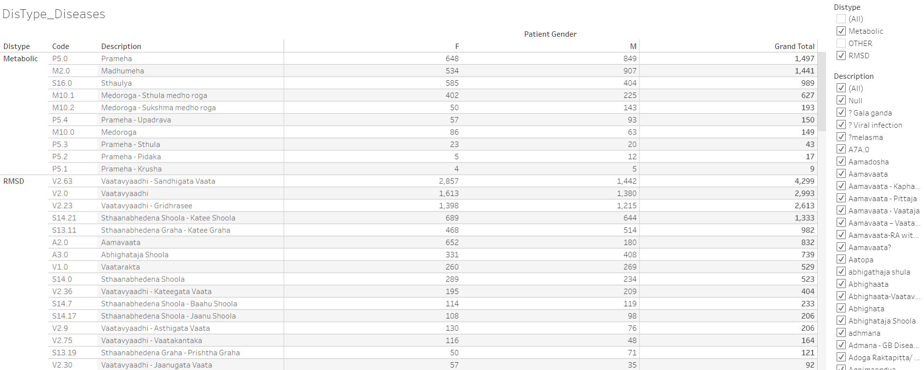
RMSD and Metabolic disease group
analysis (4/9)
Data version: 2011 to Oct 2017
HOSP MGMT
DOC /PATIENT
RESEARCH
AYUSH
HEALTHCARE
https://public.tableau.com/views/01SQL_Dis_Med_Ser/MedicineByDay?:display_count=y&:origin=viz_share_link

Slide 34
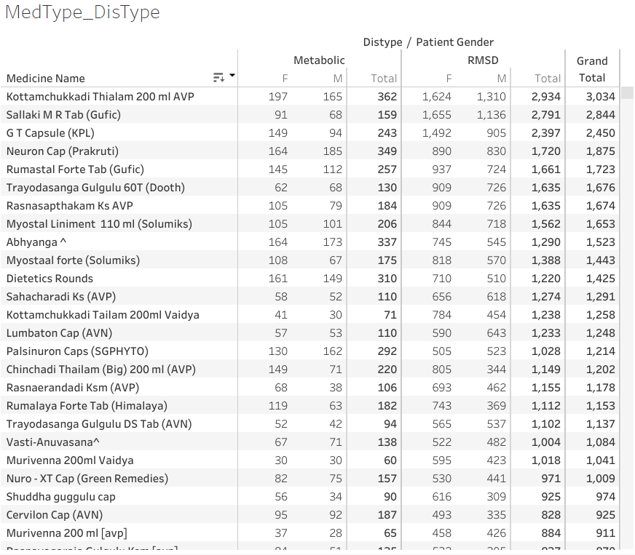
RMSD and Metabolic disease group
analysis (5/9)
Data version: 2011 to Oct 2017
HOSP MGMT
DOC /PATIENT
RESEARCH
AYUSH
HEALTHCARE
https://public.tableau.com/views/01SQL_Dis_Med_Ser/MedicineByDay?:display_count=y&:origin=viz_share_link

Slide 35
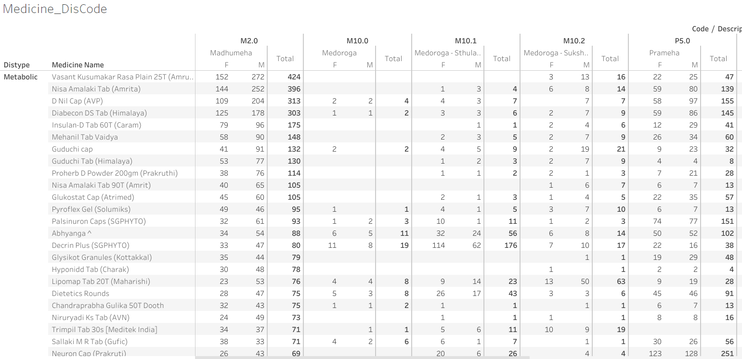
RMSD and Metabolic disease group
analysis (6/9)
Data version: 2011 to Oct 2017
HOSP MGMT
DOC /PATIENT
RESEARCH
AYUSH
HEALTHCARE
https://public.tableau.com/views/01SQL_Dis_Med_Ser/MedicineByDay?:display_count=y&:origin=viz_share_link

Slide 36
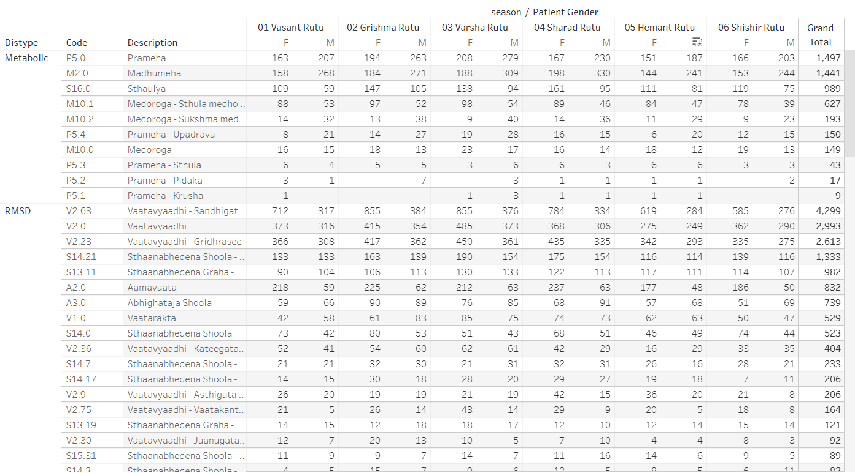
RMSD and Metabolic disease group
analysis (7/9)
Data version: 2011 to Oct 2017
HOSP MGMT
DOC /PATIENT
RESEARCH
AYUSH
HEALTHCARE
https://public.tableau.com/views/01SQL_Dis_Med_Ser/MedicineByDay?:display_count=y&:origin=viz_share_link

Slide 37
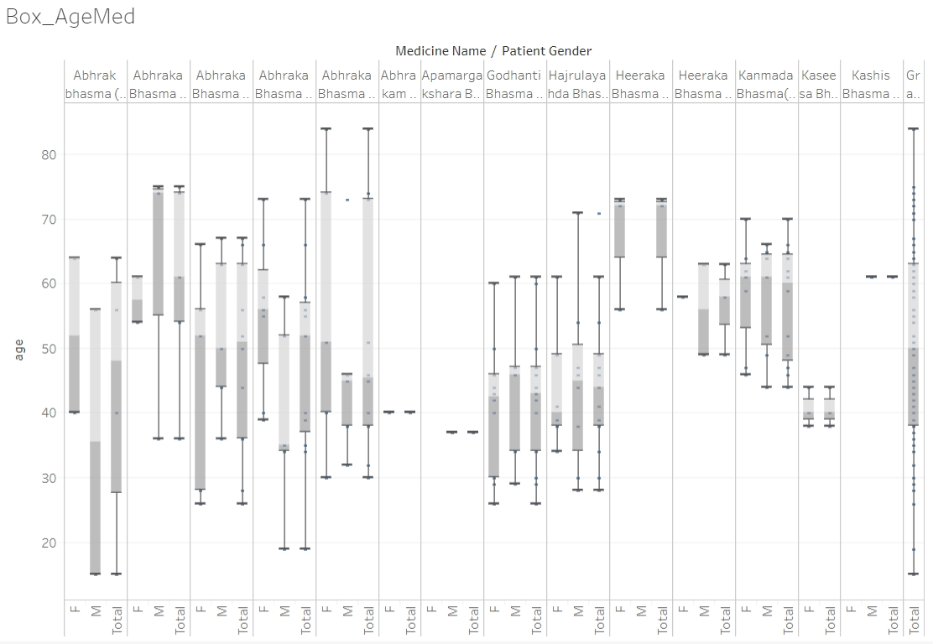
RMSD and Metabolic disease group
analysis (8/9)
Data version: 2011 to Oct 2017
HOSP MGMT
DOC /PATIENT
RESEARCH
AYUSH
HEALTHCARE
https://public.tableau.com/views/01SQL_Dis_Med_Ser/MedicineByDay?:display_count=y&:origin=viz_share_link

Slide 38
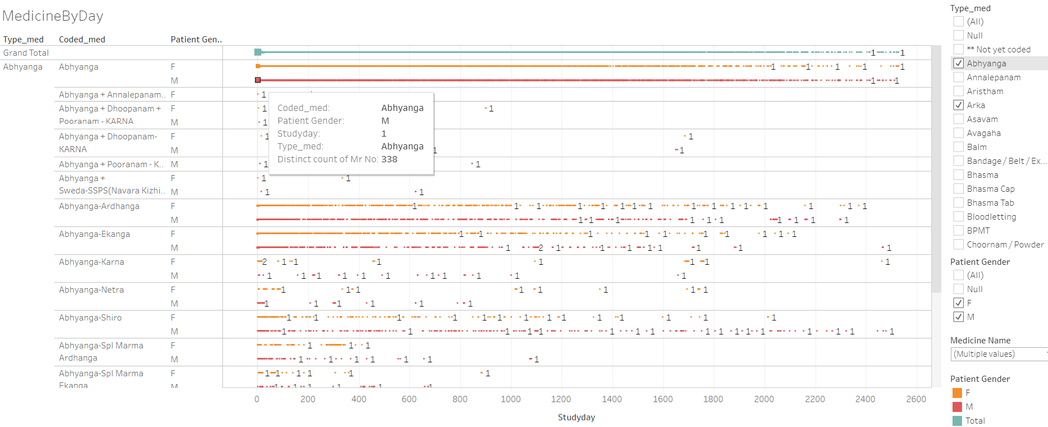
RMSD and Metabolic disease group
analysis (9/9)
Data version: 2011 to Oct 2017
HOSP MGMT
DOC /PATIENT
RESEARCH
AYUSH
HEALTHCARE
https://public.tableau.com/views/01SQL_Dis_Med_Ser/MedicineByDay?:display_count=y&:origin=viz_share_link

Slide 39
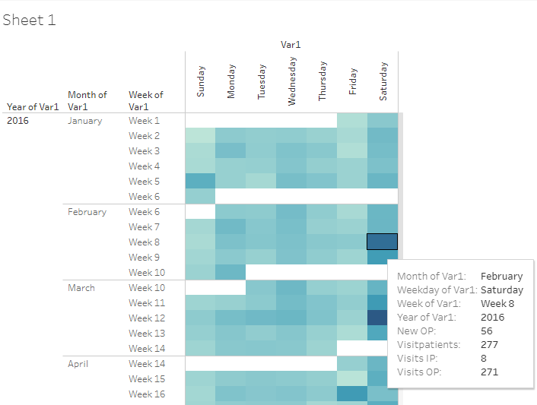
Operational view of number of patients
Data version: 2011 to Oct 2016
HOSP MGMT
DOC /PATIENT
RESEARCH
AYUSH
HEALTHCARE
Patients visiting on each day, details of visits displayed in the tooltip maximizing the usage of space
Supporting data to design availability of people on shifts on week days and week ends
https://public.tableau.com/views/04_calendar_view/Sheet1?:display_count=y&:origin=viz_share_link

Slide 40
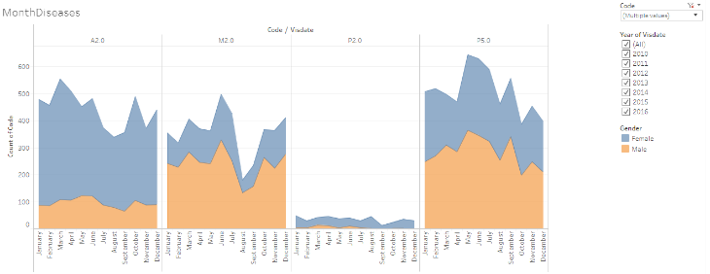
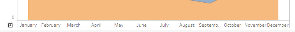
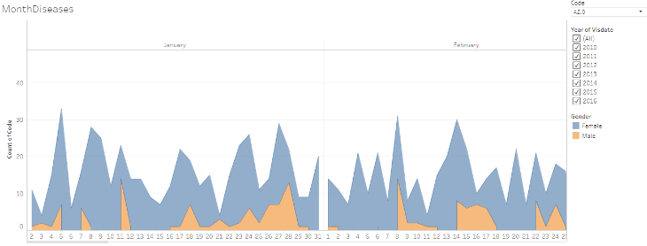
Frequency count of patients for each disease by month by gender
Data version: 2011 to Oct 2016
HOSP MGMT
DOC /PATIENT
RESEARCH
AYUSH
HEALTHCARE
This visual opens for each day, by clicking on “+” sign on the x-axis, showing the operational as well as scientific usefulness.
Seasonal variation,
Gender wise variation,
Disease variation
https://public.tableau.com/shared/GXXZXKK29?:display_count=y&:origin=viz_share_link

Slide 41
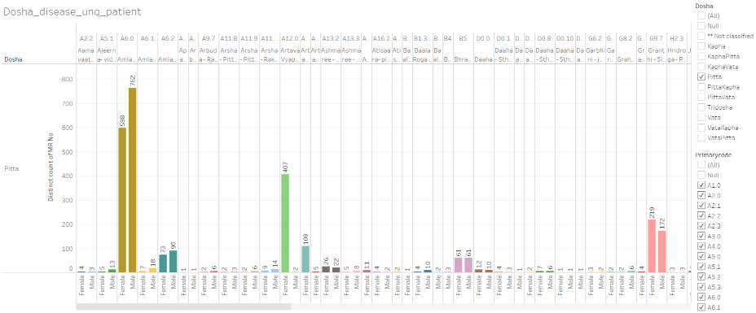
Dosha and disease
Data version: 2011 to Oct 2016
HOSP MGMT
DOC /PATIENT
RESEARCH
AYUSH
HEALTHCARE
https://public.tableau.com/views/Disease_by_dosha_type/Dosha_disease_unq_patient?:display_count=y&:origin=viz_share_link

Slide 42
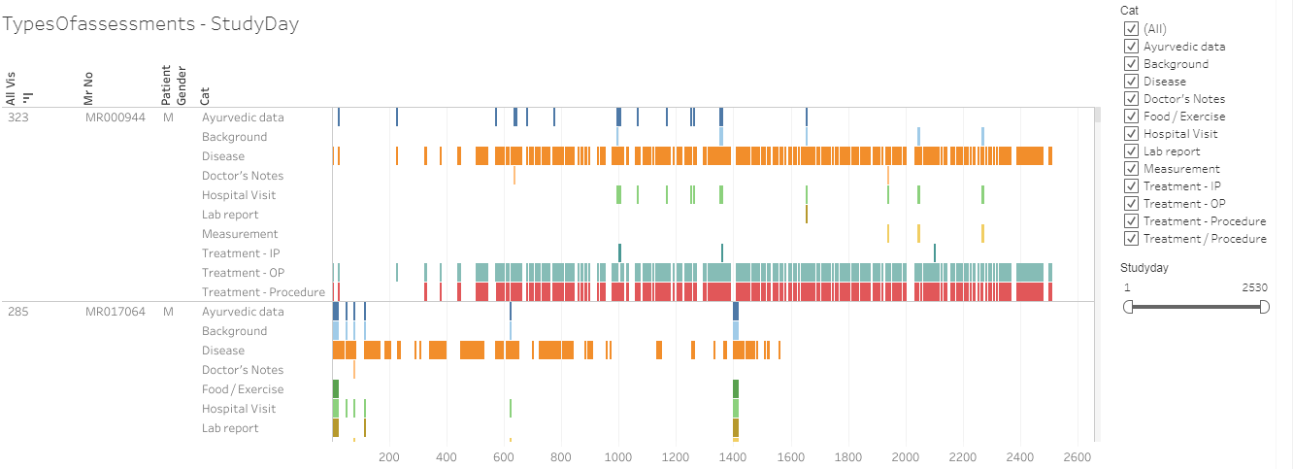
Types of assessment captured by CRFs for individual patients by visit day
Data version: 2011 to Oct 2017
HOSP MGMT
DOC /PATIENT
RESEARCH
AYUSH
HEALTHCARE
Data for individual patient displayed by visit day
Categorization
https://public.tableau.com/views/03_typesOfassessment/TypesOfassessments-StudyDay?:display_count=y&:origin=viz_share_link

Slide 43
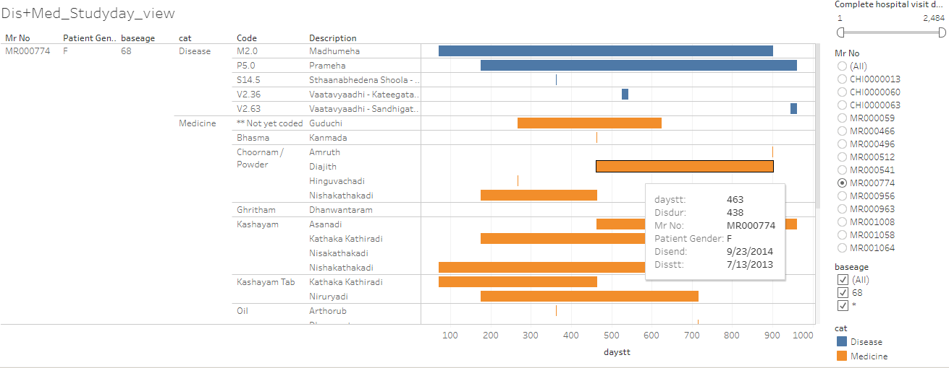
Patient profile view of individual patient by disease and medicine
Data version: 2011 to Oct 2017
HOSP MGMT
DOC /PATIENT
RESEARCH
AYUSH
HEALTHCARE
Disease and medicine combined view
https://public.tableau.com/shared/HCSMCRXYP?:display_count=y&:origin=viz_share_link

Slide 44
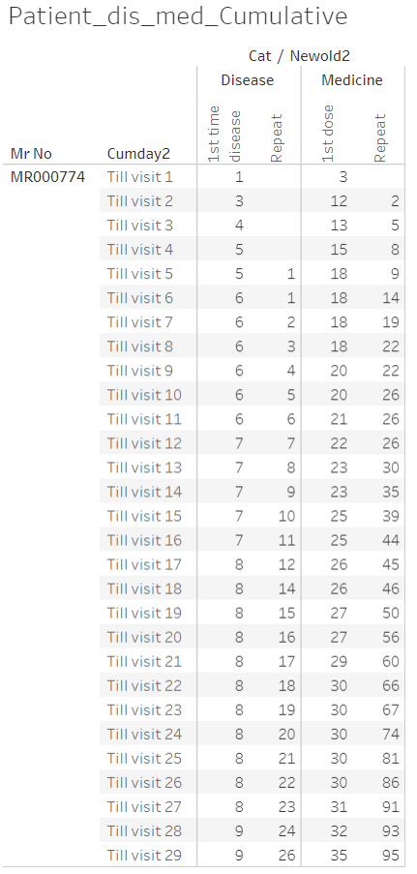
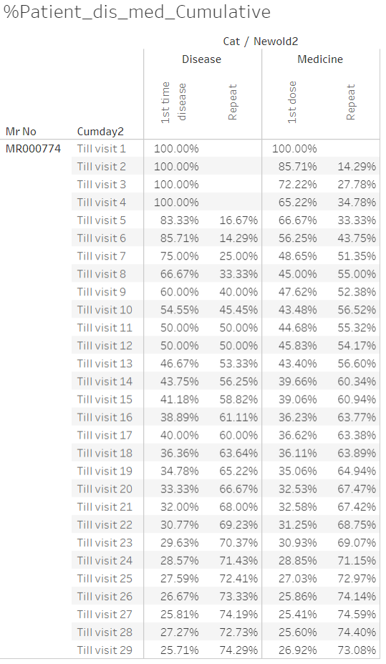
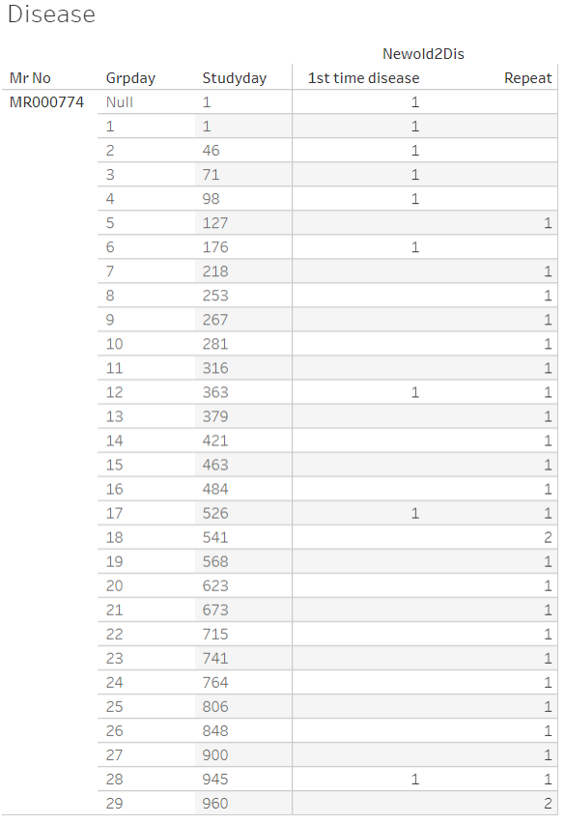
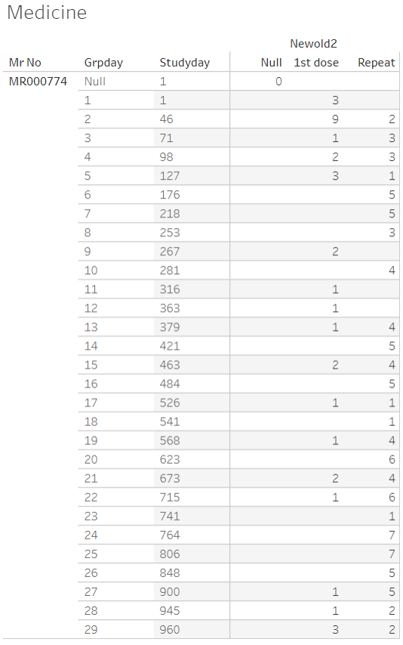
Number of reported diseases and prescribed medicines for each patient by visit
Data version: 2011 to Oct 2017
HOSP MGMT
DOC /PATIENT
RESEARCH
AYUSH
HEALTHCARE
https://public.tableau.com/views/080_medicine_dis_all_met_rmsd_prop/Dashboard1?:display_count=y&:origin=viz_share_link
https://public.tableau.com/views/080_medicine_dis_repeat_prop_cumulative/Dashboard1?:display_count=y&:origin=viz_share_link

Slide 45
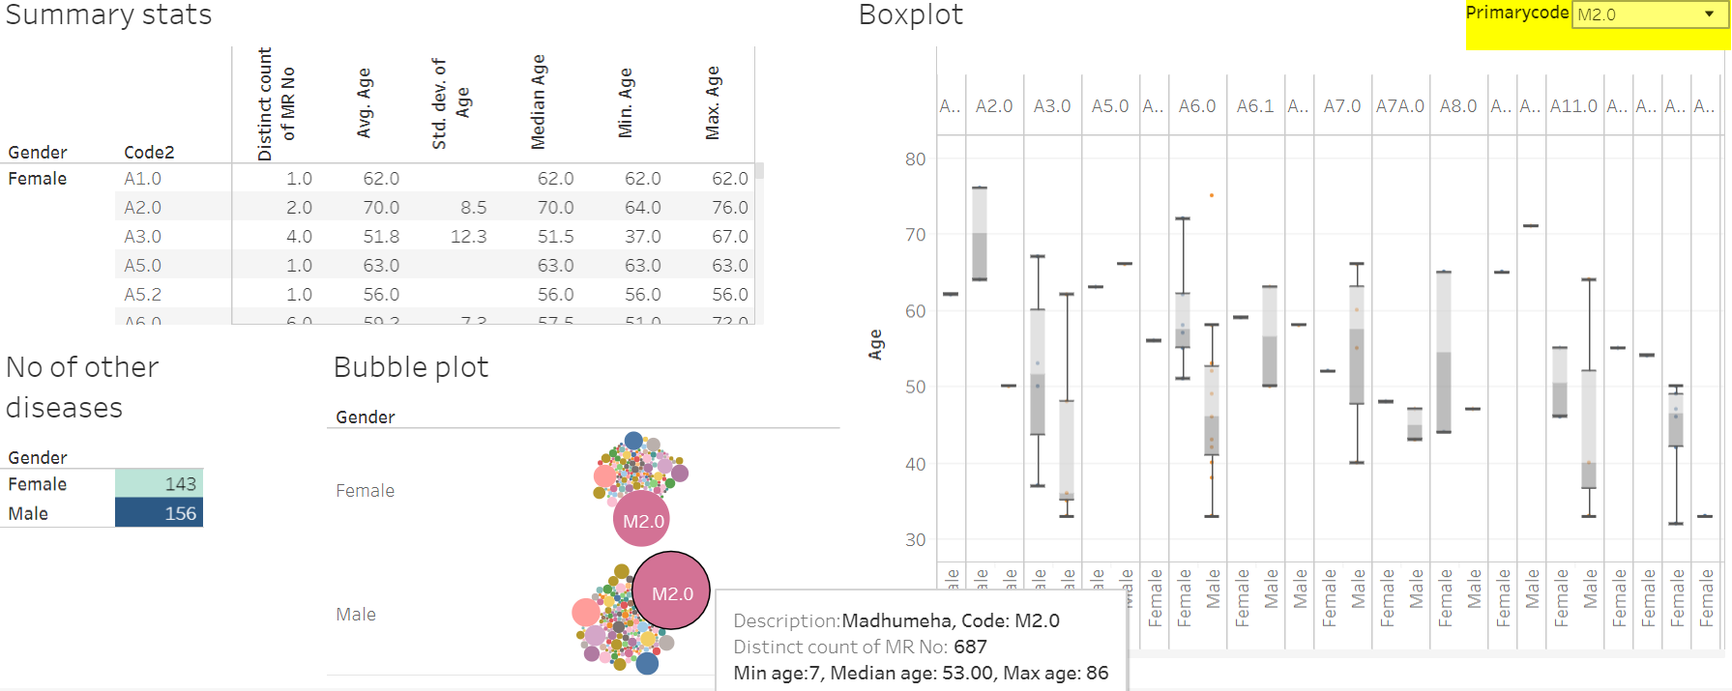
Patients with Madhumeha and additional diseases reported (1/2)
Data version: 2011 to Oct 2016
HOSP MGMT
DOC /PATIENT
RESEARCH
AYUSH
HEALTHCARE
https://public.tableau.com/views/Primary_disease_and_all_other_diseases/Dashboard2?:display_count=y&:origin=viz_share_link

Slide 46
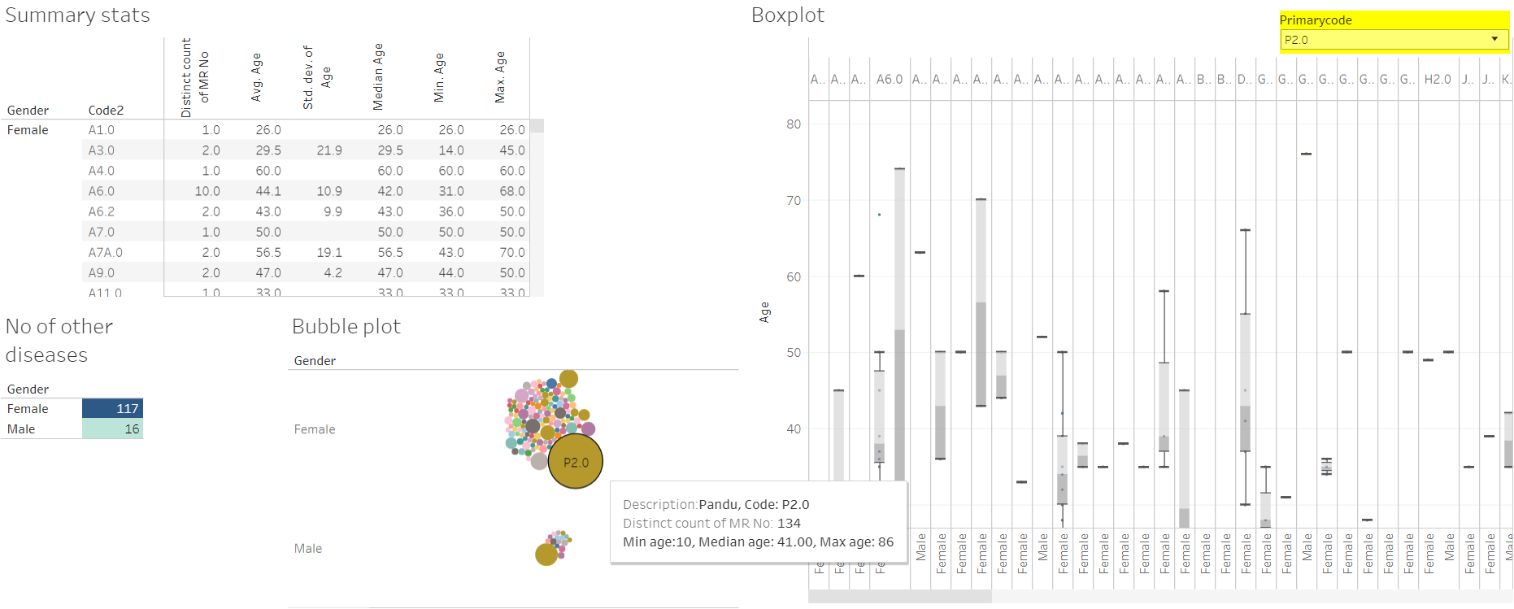
Data version: 2011 to Oct 2017
Patients with Pandu and additional diseases reported (2/2)
HOSP MGMT
DOC /PATIENT
RESEARCH
AYUSH
HEALTHCARE
https://public.tableau.com/views/Primary_disease_and_all_other_diseases/Dashboard2?:display_count=y&:origin=viz_share_link

Slide 47
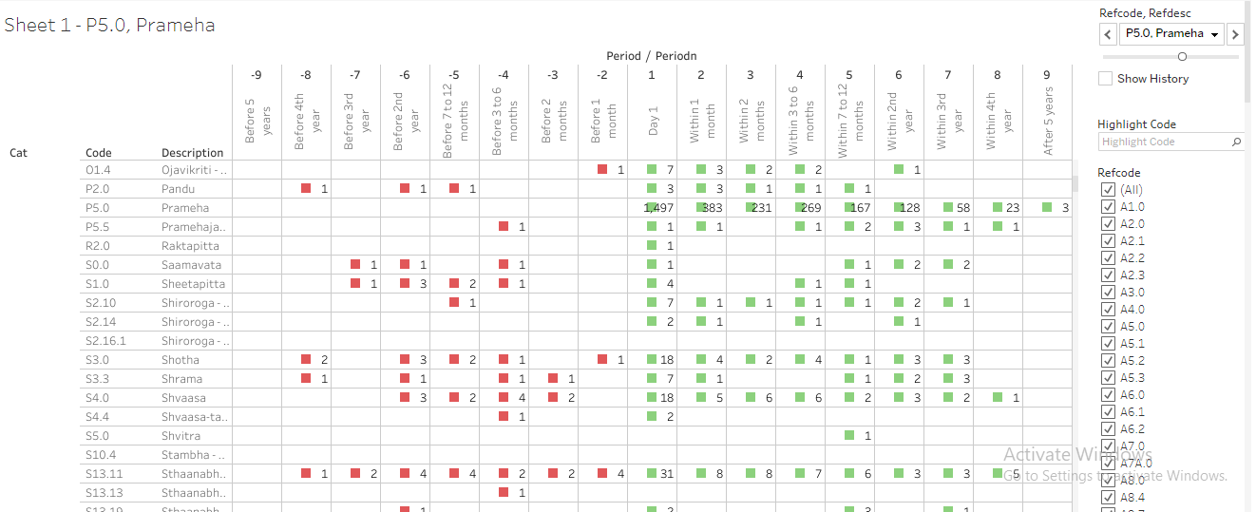
Pre and post co-morbidities for Prameha
Data version: 2011 to Oct 2017
HOSP MGMT
DOC /PATIENT
RESEARCH
AYUSH
HEALTHCARE
Prameha has been reported by 1497 patients. Out of these 383 patients visit hospital within 1st month, 231, 269, 167, 128, etc are in the following time points.
Other lines in the table provide details about diseases reported by these 1497 patients.
Bottom section of the table provides information about the treatment details for these patients.
https://public.tableau.com/views/085_dis_1st_time_refCal_NodesEdges/Sheet1?:display_count=y&:origin=viz_share_link

Slide 48


Relationship between diseases and medicines
Data version: 2011 to Oct 2017
HOSP MGMT
DOC /PATIENT
RESEARCH
AYUSH
HEALTHCARE
Amavaata [https://coursephd.github.io/nodediagram/A2_0/] Amavaata by period [https://coursephd.github.io/nodediagram/A2_0byperiod/]
Prameha [https://coursephd.github.io/nodediagram/P5_0_Prameha/] Prameha by period [https://coursephd.github.io/nodediagram/P5_0_Pramehabyperiod/]

Slide 49


Circular view representation of disease and medicine co-occurrences, pre and post
Data version: 2011 to Oct 2017
HOSP MGMT
DOC /PATIENT
RESEARCH
AYUSH
HEALTHCARE
Interpretation, Many green lines means:
There is a greater chance of diseases reported by patients
There is a greater chance of a medicine prescribed for a disease
Visualization of
Co-occurrences of disease and medicine
Co-occurrences of disease and disease
https://public.tableau.com/views/085_dis_count_edges_3rd_byPeriod02try/PrimaryDis_relatedDisMed2?:display_count=y&:origin=viz_share_link

Slide 50

RMSD and Metabolic disease group analysis
Pre and Post analysis for disease
Data version: 2011 to Oct 2017
HOSP MGMT
DOC /PATIENT
RESEARCH
AYUSH
HEALTHCARE
Disease trajectories are calculated as diseases reported chronologically for each reference disease
Pre-disease trajectory
Post-disease trajectory
Compare all trajectories using a mathematical distance (example used: Jaccard distance)
Find the most similar distance Pre and Post
0: least similar, 1: most similar
Plot these as 0-0.25, 0.25-0.5, 0.5-0.75, 0.75-1
https://public.tableau.com/views/DistanceMeasuresTimePeriod-086prgm/DiseaseMaxDist?:display_count=y&:origin=viz_share_link

Slide 51

RMSD and Metabolic disease group analysis
Pre and Post analysis for medicine
Data version: 2011 to Oct 2017
HOSP MGMT
DOC /PATIENT
RESEARCH
AYUSH
HEALTHCARE
https://public.tableau.com/views/DistanceMeasures-Medicines/MedicineMaxDist?:display_count=y&:origin=viz_share_link

Slide 52

Radar plot: visualize many parameters of a disease to see similarity / dis-similarity
Data version: 2011 to Oct 2017
HOSP MGMT
DOC /PATIENT
RESEARCH
AYUSH
HEALTHCARE
Each disease is visualized as a percentile for the following parameters:
Distinct number of patients
Number of times a disease is reported
Number for a specific disease (chronological number of disease reported by a patient)
Number of diseases before the specific disease
Number of diseases after the specific disease
Number of treatments before the specific disease
Number of treatments after the specific disease
A heptagon visualizes a disease
Differing shapes provide differences reported in the data
https://public.tableau.com/views/300_radar_plot/Radar-Plot-trellis?:display_count=y&:origin=viz_share_link
https://github.com/coursephd/PostgreSQL/blob/master/300_radar_plot_tableu.R

Slide 53

Disease and treatment relation
Data version: 2011 to Oct 2017
HOSP MGMT
DOC /PATIENT
RESEARCH
AYUSH
HEALTHCARE
https://public.tableau.com/views/305_medicine_dur_by_dis/TreeMapDisMed-Parameter?:display_count=y&:origin=viz_share_link
Notes:
Can we write conclusion of the first data analysis and what did we infer from this data which can go as an evidence or input for future studies?
How does this confirm your claim or support your objective?

Slide 54
Similar cases studies
Data version: 2011 to Oct 2017
HOSP MGMT
DOC /PATIENT
RESEARCH
AYUSH
HEALTHCARE
Vrikka roga
Group of cancers
Vrikka roga analysis:
https://public.tableau.com/views/01VrikkaRoga_SQL_Dis_Med_Ser/Vrikka_patients?:display_count=y&:origin=viz_share_link
https://public.tableau.com/views/01VrikkaRoga_Before_After/Sheet1?:display_count=y&:origin=viz_share_link
Cancer analysis:
https://public.tableau.com/views/01Cancer_SQL_Dis_Med_Ser/Cancer_patients?:display_count=y&:origin=viz_share_link
https://public.tableau.com/views/01Cancer_Before_After/Sheet1?:display_count=y&:origin=viz_share_link

Slide 55




Comorbidity analysis (1/2)
Data version: 2011 to Oct 2017
Clinical and epidemiological studies indicate that disease comorbidities have a great impact
on the evolution of health status,
selection of appropriate treatments and
health system costs
Comorbidity analysis can be carried out based on EHR data:
Patient Data
Diagnosis Data
Admission Data
Index Disease Data
HOSP MGMT
DOC /PATIENT
RESEARCH
AYUSH
HEALTHCARE
Reference to the R package: comoRbidity

Slide 56






Comorbidity analysis (2/2)
Data version: 2011 to Oct 2017
HOSP MGMT
DOC /PATIENT
RESEARCH
AYUSH
HEALTHCARE
Reference to the R package: comoRbidity

Slide 57
Parkinson Disease data analysis – case series (1/2)
Data version: 2011 to June 2017
HOSP MGMT
DOC /PATIENT
RESEARCH
AYUSH
HEALTHCARE
Section 1:
A “case series” in real clinical practice, IAIM hospital from 2011 to 2017
The hospital database covers more than 300 patients deemed to be PD patients
Some of them inaccurately classified as "kampa vata" patients
Clinical challenge could be explained while diagnosing the patients correctly (some frequency counts already shown for V2.34.0)
Need to explain about the Not PD, PD and PD+ categories
Section 2:
Table "Number of patients with diagnosis type and gender" -- provides insights on male, female distribution
Males are almost 2 times of females. Is this is the natural course of disease?
Section 3:
Description about the duration of illness: Patients in PD and PD+ categories have similar mean and median years of illness
Duration of follow-up for PD patients is more than for PD+ patients
Female PD patients are coming for longer median duration than the male patients
Duration is depicted in terms of number of visits as well

Slide 58
Parkinson Disease data analysis – case series (2/2)
Data version: 2011 to June 2017
HOSP MGMT
DOC /PATIENT
RESEARCH
AYUSH
HEALTHCARE
Section 4:
Analysis on 18 patients who are categorized into PD and PD+ having UPDRS score. We will need to explain why only for 18 patients UPDRS score captured, in order avoid any questions on any kind of bias
Section 5:
For various parameters baseline, final value, and change from baseline are calculated
Page 8 onwards the document: Baseline values for PD patients are lower than that for PD+ patients (~15 vs. ~40), in both the groups, some reduction is shown in the final value
Change from baseline < 0 is improvement, > 0 is deterioration, = 0 is no change
-- UPDRS shows some reduction
-- Tremors / functional score do not reduce for PD patients, but for PD+ patient they reduce
-- Rigidity reduces for PD patients, and remain almost similar for PD+ patients
Section 6:
Page 13: status of medications and corresponding scores out these 18 patients. 5 patients who are drug naive should be explained as Patients directly opting for Ayurvedic treatment. 2 patients for whom drug was reduced need to be explained as special cases. Is it possible to explain for how long the drug was reduced.
Section 7:
If there are multiple post baseline values for all the UPDRS, tremors, functional scores, etc. then additional plots

Slide 59
Top 15 diseases treated
Data version: 2011 to Oct 2016
Most of the traditional diseases appear on the list of most frequent diseases
HOSP MGMT
DOC /PATIENT
RESEARCH
AYUSH
HEALTHCARE
Disease | Grand Total | Female | Male
Vatavyadhi – Sandhigata vaata | 3577 | 2339 | 1238
Vatavyadhi | 2783 | 1507 | 1276
Vatavyadhi – Gridhrasee | 2034 | 1055 | 979
Vatavyadhi – Avabaahuka | 1482 | 865 | 617
Amlapitta | 1429 | 628 | 801
Prameha | 1375 | 585 | 790
Shvaasa | 1228 | 543 | 685
Netra Roga | 1120 | 516 | 604
Madhumeha | 1063 | 369 | 694
Staanabhedana Shoola – Katee Shoola | 978 | 494 | 484
Sthaulya | 831 | 487 | 344
Greeva Graha | 821 | 399 | 422
Kaasa | 814 | 410 | 404
Staanabhedana Graha – Katee Graha | 796 | 363 | 433
Kshudra Roga | 725 | 378 | 347

Slide 60



Wod2vec analysis
Data version: 2011 to Oct 2017
Top 10 closest and Top 10 farthest
To make the visualizations more relevant
relationships between a query disease (in red),
its 10 most similar diseases in the model (in blue), and
10 farthest diseases from the vocabulary (in green).
HOSP MGMT
DOC /PATIENT
RESEARCH
AYUSH
HEALTHCARE
Google Colab python program: https://colab.research.google.com/drive/1pJv39GrrFjadaoI4m9QuPw4W4-i2s9lh?usp=sharing

Slide 61

FastText analysis
Data version: 2011 to Oct 2017
The text was created as a textual representation
of diseases and treatments, age groups and gender
HOSP MGMT
DOC /PATIENT
RESEARCH
AYUSH
HEALTHCARE
Google Colab python program: https://colab.research.google.com/drive/1rZy-nNC3E5sK7K6V9mbs9qD6-SptJnPT?usp=sharing

Slide 62



Analysis of wordembeddings visualized using TensorFlow
Data version: 2011 to Oct 2017
HOSP MGMT
DOC /PATIENT
RESEARCH
AYUSH
HEALTHCARE
Attaching a link to the visuals created based on
Dis-M2-F-Age30-40 M2 (madhumeha) Females 30 -40 age range | Dis-M2-M-Age30-40 M2 (madhumeha) Males 30 -40 age range | Dis-M2-All-AgeAll M2 (madhumeha) All patient All age range
dis_m18,med_501, med_1422, med_692, do not appear as closest points for males may be present in top 50 but not in top 10 | med_1652,med_1507, med_1496, med_1622 do not appear as closest points for females may be present in top 50 but not in top 10 | As this covers all patients, many closest point appear in 2 adjacent cells . dis_s18, med_1880, med_25, med_1591, med_1072 which are closest in the whole patient population are not the closest in the 2 groups represented here.
TensorFlow link:
https://projector.tensorflow.org/?config=https://raw.githubusercontent.com/coursephd/PostgreSQL/master/DeepLearning/002-dismed-subgrp-w2v/099-multiple-config.json

Slide 63


Based on the Recurrent Neural Network predict the next word (disease, treatment)
Data version: 2011 to Oct 2017
HOSP MGMT
DOC /PATIENT
RESEARCH
AYUSH
HEALTHCARE
Convert EHR data to a “text” as corpus of disease1, ..., disease, medicine1, ..., medicinen combinations
Run the “text generation recurrent neural network” model
Once the model is created then execute e.g. “textgen.generate(5, prefix="DIS_M2")
Google Colab program: https://colab.research.google.com/drive/18jzHoTgfKSerJt9vexGBHq0BIVOp3W_C?usp=sharing
https://github.com/minimaxir/textgenrnn/blob/master/README.md

Slide 64
Visual exploration of Word Vector embeddings
Data version: 2011 to Oct 2017
HOSP MGMT
DOC /PATIENT
RESEARCH
AYUSH
HEALTHCARE
https://graphics.cs.wisc.edu/Papers/2017/HG17/HG17_poster_summary.pdf
Google colab program: https://colab.research.google.com/drive/10cp16curxzdZyklw5JKFXALru7dbGYvW?usp=sharing

Slide 65

Ongoing work
Calculate DALY scores for diseases -- use as a pseudo endpoint
DeepCare - https://github.com/trangptm/DeepCare
OHDSI - https://ohdsi.org/, https://github.com/OHDSI/PatientLevelPrediction
MED2VEC
RETAIN

Slide 66
Documents to Data: Ayurveda Practice Need
GIGO!
Precision in documentation
Patient data
Demography, socio-economics, clinical history…
Diagnosis data
Risk, causation, symptoms, lab data, diagnosis…
Interventions
Drug, diet, lifestyle (exercise, meditation..), advice, …
Outcomes
Clinicians assessment, Patient reported outcomes, lab…

Slide 67
How does this study help? Ayurdata expert could contribute in the following areas:
Clinical operations:
Operational efficiencies
R&D:
Automated documentation for regulatory / audit needs
Clinical decision support
Reproducible research
Public health:
Patterns of diseases and medicines
Disease surveillance
Population health management
Data to actionable information
Evidence based medicine:
Empirical evidence
Nature and context of disease
Analysis of clinical practice data
New needs:
New needs never thought of in ayurvedic area so far*
Much more than excel subsets / pivot tables ...
Complex computing
Advanced visualizations -- A picture is worth a thousand words
Pioneering effort and new contributions: as this kind of work was never done in ayurvedic area
*: our assumption, as no one has seen anything like this before within ayurverda

Slide 68
Thank you

Slide 69

RMSD and Metabolic disease group
analysis (1/9)
Data version: 2011 to Oct 2017
HOSP MGMT
DOC /PATIENT
RESEARCH
AYUSH
HEALTHCARE
Repeat of the earlier data representation
https://public.tableau.com/views/01SQL_Dis_Med_Ser/MedicineByDay?:display_count=y&:origin=viz_share_link

Slide 70

RMSD and Metabolic disease group
analysis (2/9)
Data version: 2011 to Oct 2017
Repeat of the earlier data representation
https://public.tableau.com/views/01SQL_Dis_Med_Ser/MedicineByDay?:display_count=y&:origin=viz_share_link

